Slide 1

Classification Of Covid19 X-ray Images Using
Convolutional Neural Network
Under the guidance of
Dr. Nandish S
Assistant Professor,
Manipal School of Information Sciences,
MAHE, MANIPAL
Presented by,
Nikhil H V - 211058012
Bharath J - 211058025
Date : 02-02-2022
1
1

Slide 2
Contents
01
Introduction
02
System Design
03
04
Data Preprocessing
Modelling
05
06
CNN Architecture
Computer Vision
07
08
Conclusion
Results
2
2

Slide 3

Introduction
Coronavirus:
3
3

Slide 4
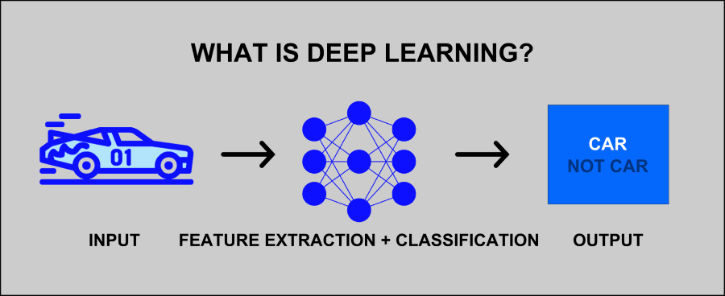
Deep Learning
4
4

Slide 5
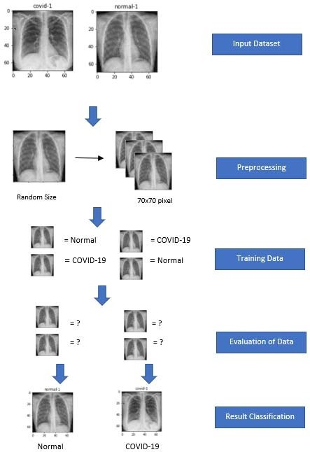
System Design
5
4

Slide 6
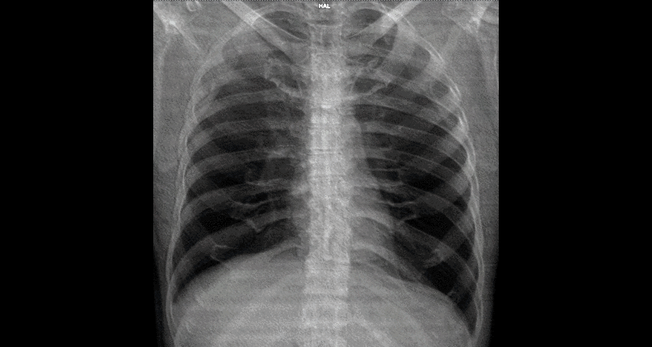
Data Preprocessing
6
5

Slide 7
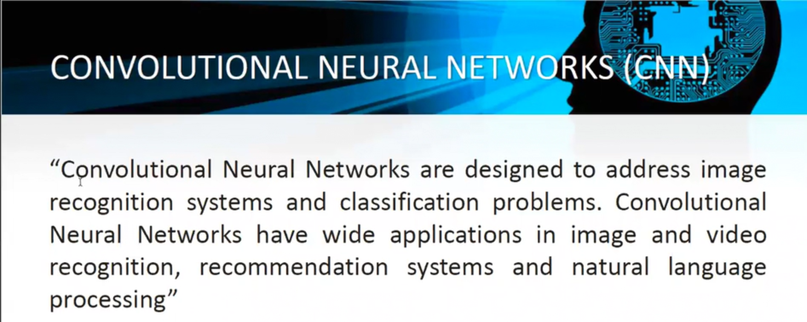
Modelling
7
5

Slide 8
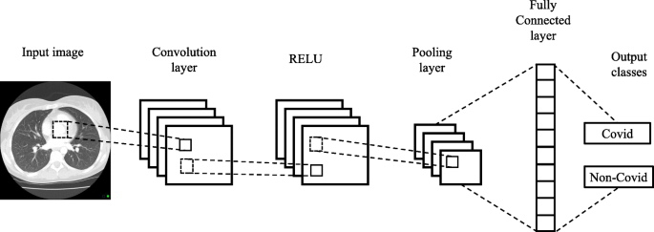
CNN Architecture
8
6

Slide 9
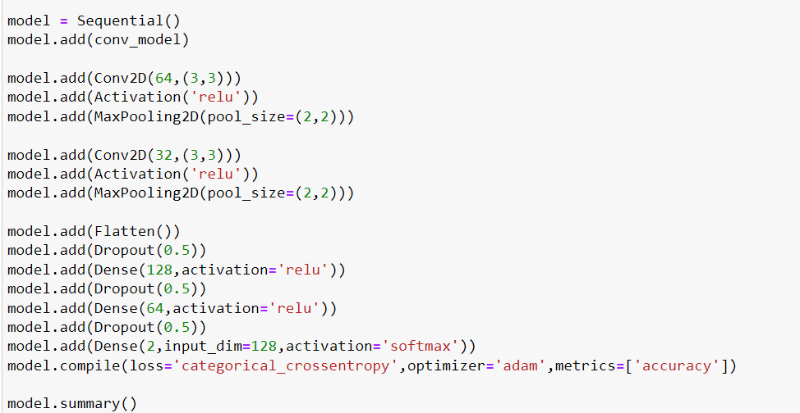
Layers
9
7

Slide 10

Computer Vision
Computer vision is a field of artificial intelligence (AI) that enables computers and systems to derive meaningful information from digital images, videos and other visual inputs and take actions or make recommendations based on that information.
14

Slide 11
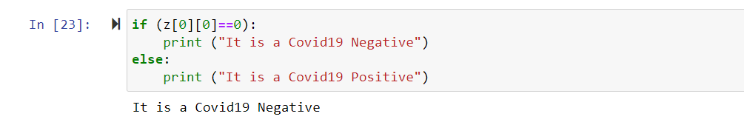
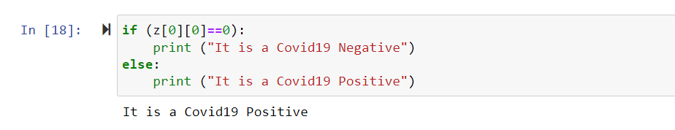
Results
15

Slide 12
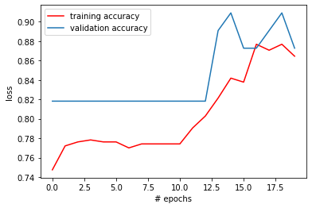
Model Accuracy
10

Slide 13
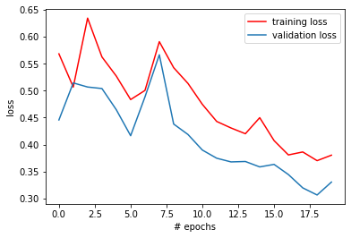
Model Loss
11
9

Slide 14
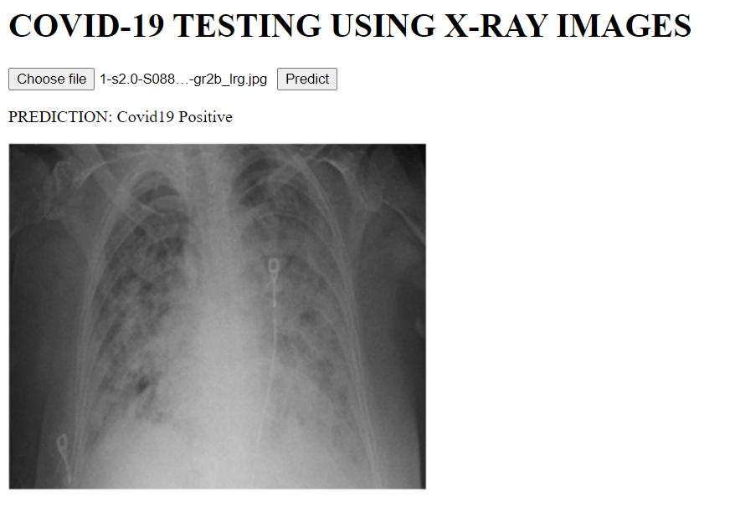
User Interface Positive Result
12

Slide 15
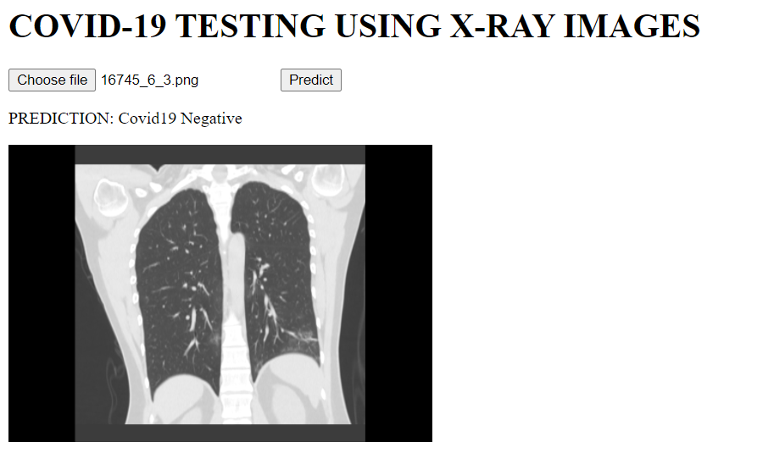
User Interface Negative Result
13

Slide 16
Conclusion
Chest X-ray images play a vital role in the detection of COVID-19, a CNN Model was used to detect COVID-19 using Chest X-ray images obtained from COVID-19 patients and Normal patients.
The model performance is 90% which is a high accuracy score with the recent origins of the virus.
This paper is only for educational and research purposes, not for medical purposes.
16

Slide 17
References
1. Yan et al., "Prediction of criticality in patients with severe Covid19 infection using three clinical features: a machine learning-based prognostic model with clinical data in Wuhan," medRxiv,p.2020.02.27.20028027,2020,doi:10.1101/2020.02.27.2002 8027.
2. K. Roosa et al., "Real-time forecasts of the COVID-19 epidemic in China from February 5 to February 24, 2020," Infect. Dis. Model.,vol.5,pp. 256–263, 2020, doi: 10.1016/j.idm.2020.02.002.
3. M. Rahimzadeh and A. Attar, "A modified deep convolutional neural network for detecting COVID-19 and pneumonia from chest X-ray images based on the concatenation of Xception and ResNet50V2," Informatics Med. Unlocked, vol. 19, p. 100360, 2020, doi: 10.1016/j.imu.2020.100360.
4. G. Litjens et al., "A survey on deep learning in medical image analysis," Med. Image Anal., vol. 42, no. December 2012, pp. 60–88, 2017, doi: 10.1016/j.media.2017.07.005.
5. Y. Zhong, "Using Deep Convolutional Neural Networks to Diagnose COVID-19 From Chest X-Ray Images," 2020, [Online]. Available: http://arxiv.org/abs/2007.09695.
6. S. Ruuska, W. Hämäläinen, S. Kajava, M. Mughal, P. Matilainen, and J. Mononen, "Evaluation of the confusion matrix method in the validation of an automated system for measuring feeding behaviour of cattle," Behav. Processes, vol. 148, pp. 56–62, 2018,
7. Rick Rogers, John Combardo, Zigard Mednieks and Blake Meiko. Android Application Development, programming with Google SDK, May 2000.
17

Slide 18
THANK YOU

